Slide 1

Team Name : Winner
Team Leader Name : Harshit Singla
Problem Statement : Al for Learning & Developer Productivity
Millions of users struggle with complex computer tasks because AI can only explain, not actually do the work.

Slide 2
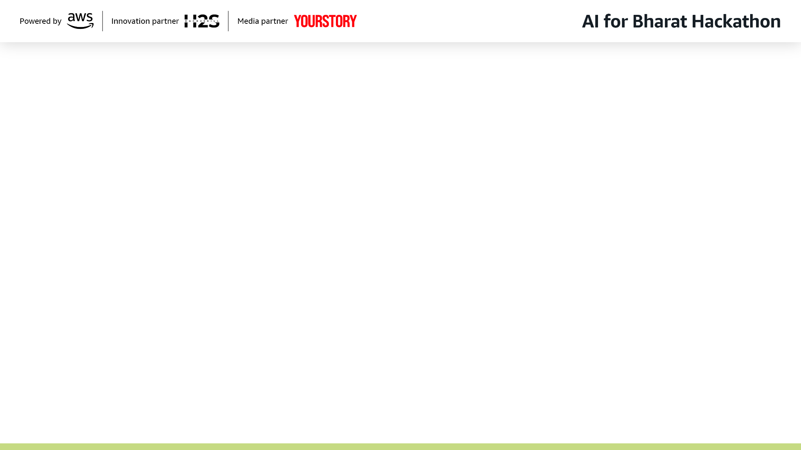

Brief about the Idea:
First-time users struggle with:
Installing software (VS Code, Python, drivers, tools, etc.)
Setting environment variables & configurations
Following long YouTube tutorials
Even experienced users waste time on:
Repetitive tasks
Debugging setups
Manual workflows
Existing Solutions (Like open-interpreter,
Self-operating Computer)
Only works with shell commands
Can’t compete our solution in GUI interactions
Is very costly in terms of LLM tokens
Are not very accurate and reliable in terms of operations
In Bharat context:
Many are first-gen computer users
Many users are not fluent in technical English
They need action, not instructions
Core gap:
AI can think, but can’t act on your computer.

Slide 3






Presenting to you JARVIS (Joint Agentic and Robotic Virtual Interaction System)
Jarvis is an AI agent that can directly operate your computer using natural language
- turning instructions into real actions.
Examples:
“Install Python and VS Code and set everything up”
“Run my program and fix the error”
“Make a number plate design for PB12AJ3158”
“Check this attendance PDF and approve OD leaves”
To this
Jarvis:
Opens apps
Clicks buttons
Types commands
Manages files
Runs programs
Performs workflows
From this
Ctrl + Click
For UI Screenshots
Ctrl + Click
For Demo Video
Incase the clicks don’t work: https://youtu.be/g9hvBvWEQdo
https://drive.google.com/drive/u/0/folders/1bqg4jbtkU7eEg3cMrYicSc13reNT1ZgT

Slide 4
List of features offered by the solution
Existing solutions only feature shell-based interactions with the OS. Which is not sufficient for real world use cases.
But JARVIS, after prioritizing shell-commands (as they are reliable), also supports GUI interactions.
Core Capabilities - Planning, multi-plane architecture, verification
Keyboard & Input (keyboard)
UI Interaction (visual_click, click_text_fast, click_text)
File & Folder (open_file, open_folder, save_file, navigate_explorer, resolve_filename)
Shell Commands (shell_command)
Code Workspace Control (write_file, read_file, append_file, create_directory)
Intelligent File Editing (replace_in_file, modify_lines, insert_at_line, delete_lines)
Critical Operations (delete_file, delete_folder)
FlexiSIGN-Specific (ensure_designcentral, create_text, set_dimensions, set_font, apply_style, move_object)
Advanced Features - Window management, readiness detection, adaptive re-scanning, permission system, debug logging, error handling, path resolution, audio feedback
Execution Modes - General, FlexiSIGN, Vision
Performance Characteristics - Speed comparisons & typical task times
Security Features - Permission system, confirmations, abort functionality
Integration Features - Mobile app, backend server, local client
Configuration - All configurable settings
Use Cases - Developer productivity, system automation, GUI automation, file management, FlexiSIGN
Unique Advantages - What makes JARVIS special
The above list shows that JARVIS has 25+ distinct operation types across three execution planes, making it a comprehensive automation system that goes far beyond simple UI clicking.

Slide 5
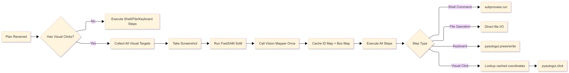
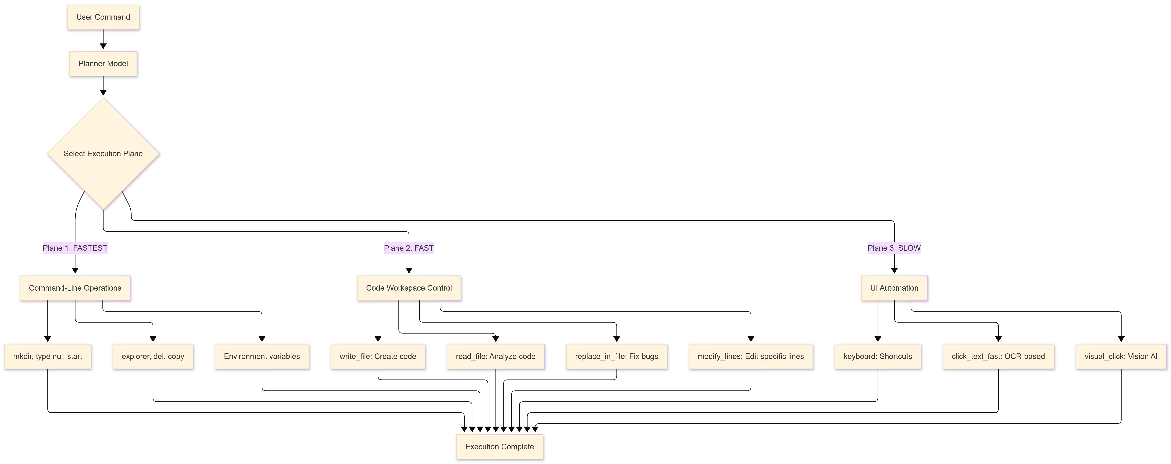
Single-Pass Vision Architecture
Three Execution Planes

Slide 6
Architecture diagram of the proposed solution:

Slide 7
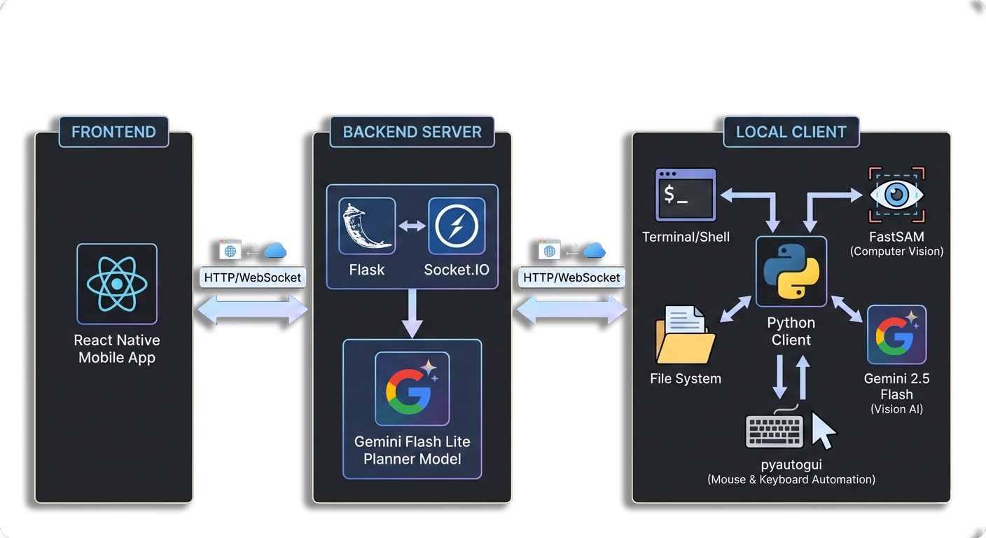
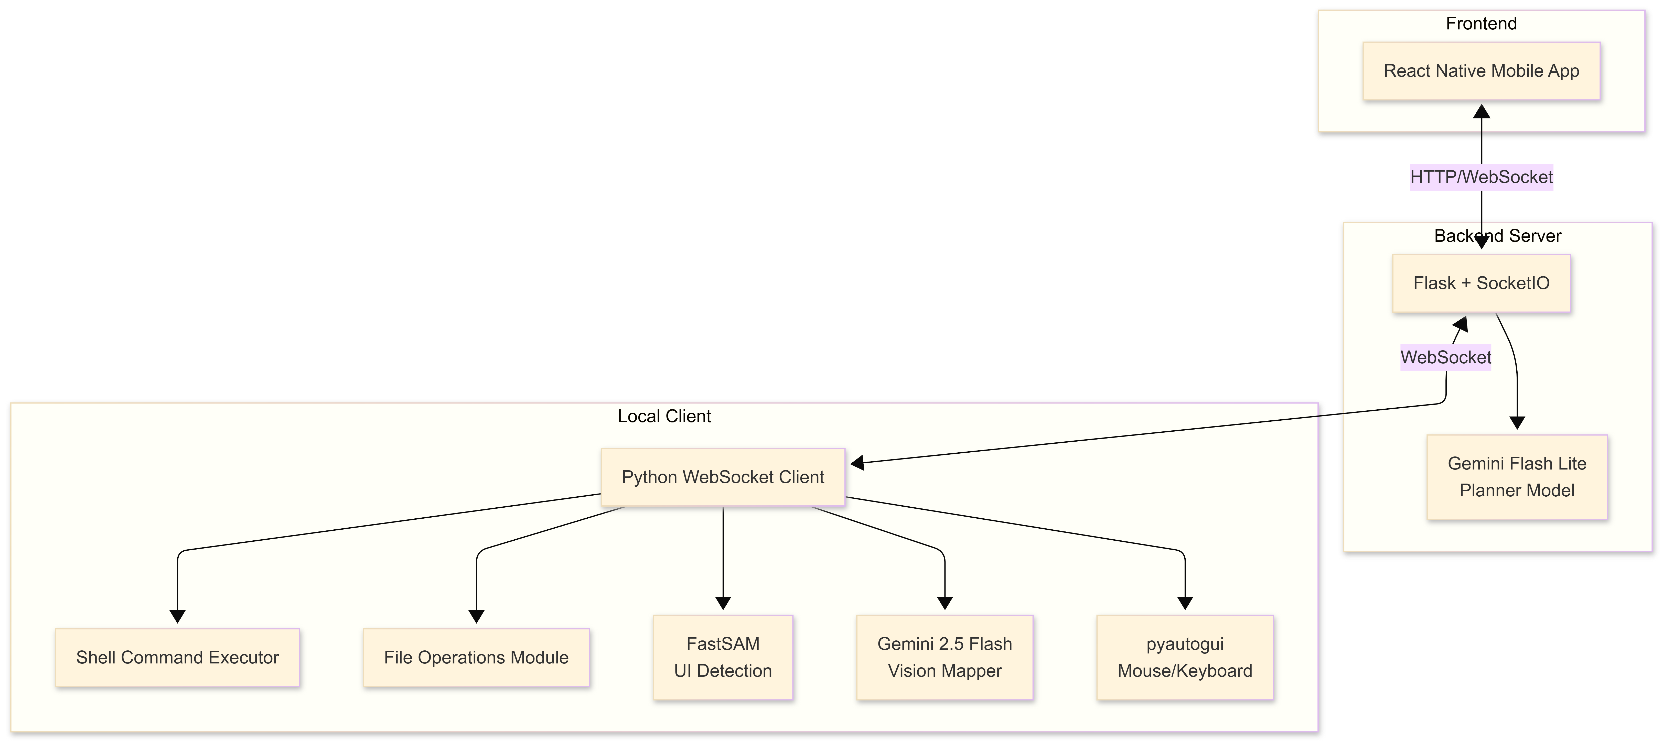
Tech
Stack

Slide 8
Use cases of Jarvis
Enables MCP servers that connect your PC to LLMs, unlocking virtually unlimited automation and integration possibilities.
Acts like a “JARVIS” tech layer that handles technical issues first—and escalates to real tech support only when needed—making support faster and more accessible.
Empowers local businesses and professionals to manage tasks remotely with high speed and efficiency.
Provides smarter guidance for students, improving learning, decision-making, and problem-solving.
Boosts developer productivity by automating tasks such as testing, debugging, and workflow management.
Processes raw inputs (e.g., image-based PDFs) and performs real actions in web and desktop applications.

Slide 9


